Slide 1
Logistics data analysis Using R programming
Monitoring outbound volume against capacity
Final term project
Taewon Kim(91221629)
2021.12.05

Slide 2
Project plan
Topic: Monitoring outbound volume against capacity
Background:
Outbound capacity plan is important to allocate total orders
Outbound volume is getting increased
Adjusted capacity needs to be applied reflecting the current trend
Objective:
Checking the highest volume within the latest 30 day daily outbound volume
Warning message if the highest volume is beyond planned capacity
Suggest a fulfillment center which capacity needs to be adjusted to higher/lower

Slide 3
Project plan
Variable:
Date(30 days)
Fulfillment centers(More than 30)
Outbound time(00:00, 01:00, 02:00, 03:00,,, 23:00): A certain daily sales start from “06:00 in the same day” to “05:59 in the next day”
Model to use:
Create random numbers for outbound volumes with right skewed data (Maximum outbound volume occurs at 21:00 ~ 24:00)
Estimate next month’s maximum daily outbound volume with using LP
Expected result:
Extract Maximum daily volume within 30 day data
Suggestion for daily outbound capacity

Slide 4
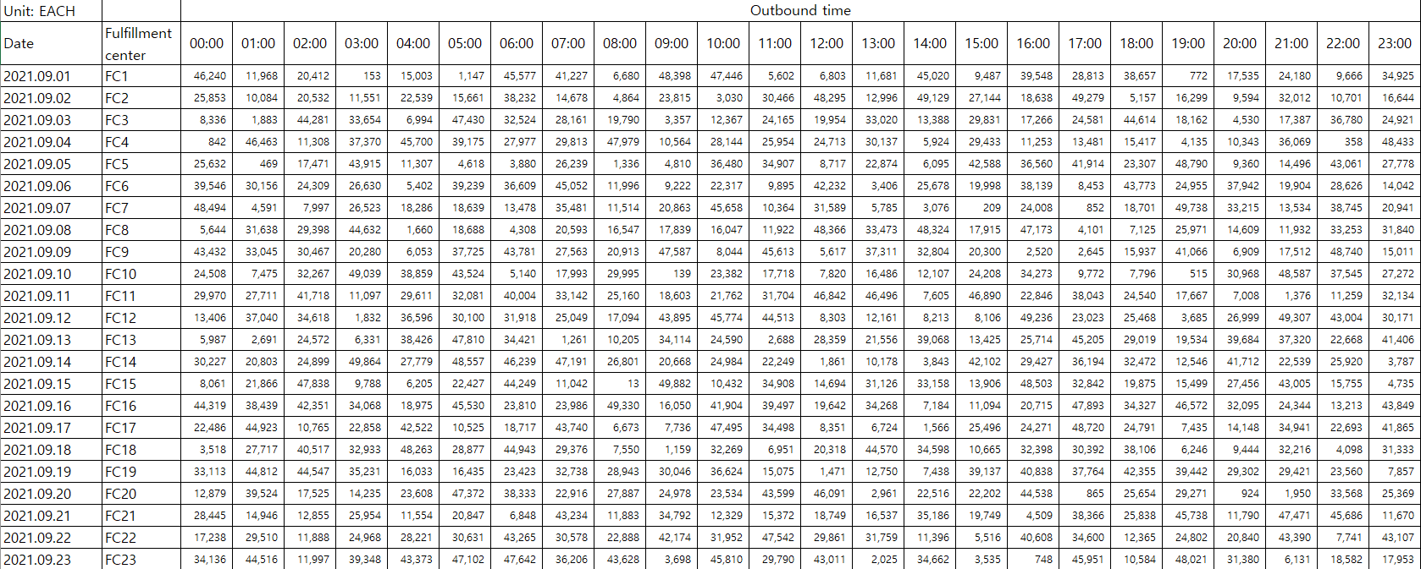
Appendix. Raw data format

